Slide 1
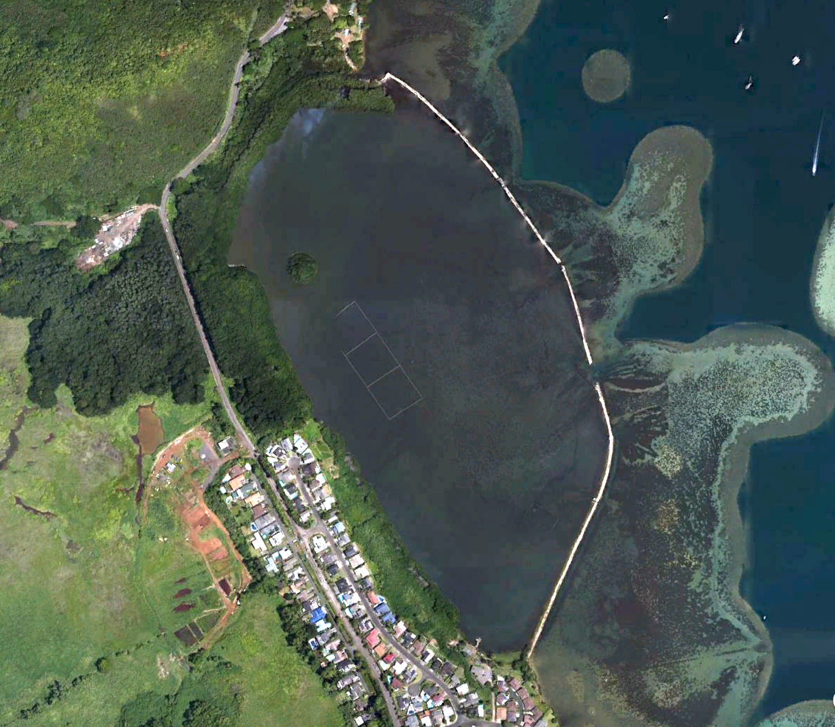
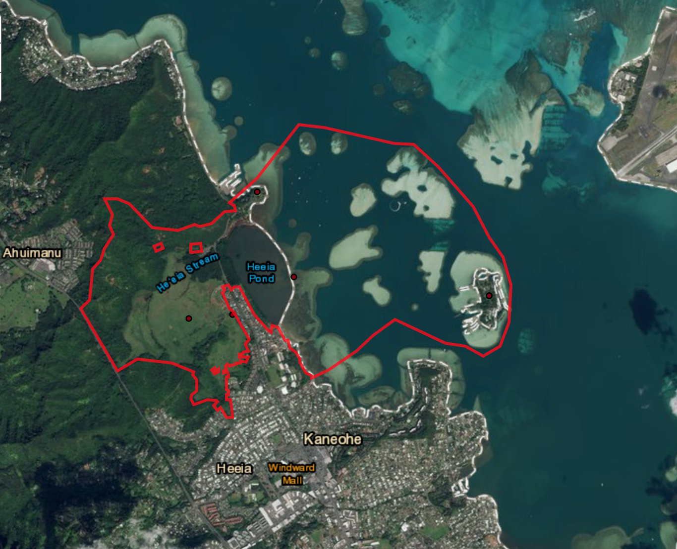
Coconut Drifters Tracking Water Circulation in a Nutshell
He’eia National Estuary Research Reserve
He’eia Fishpond

Slide 2
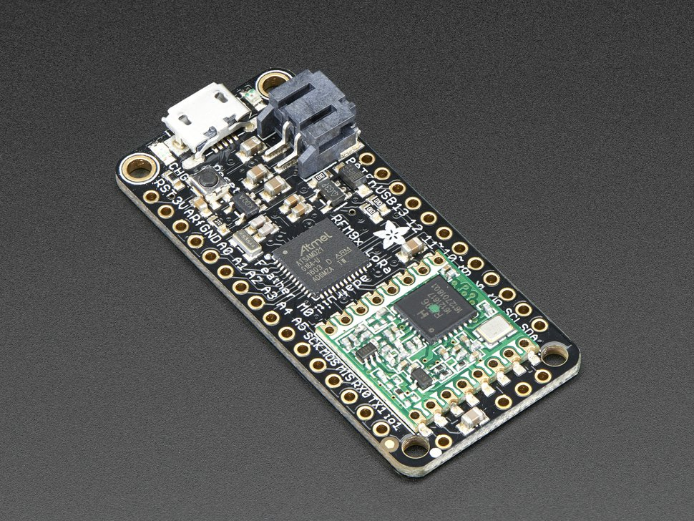
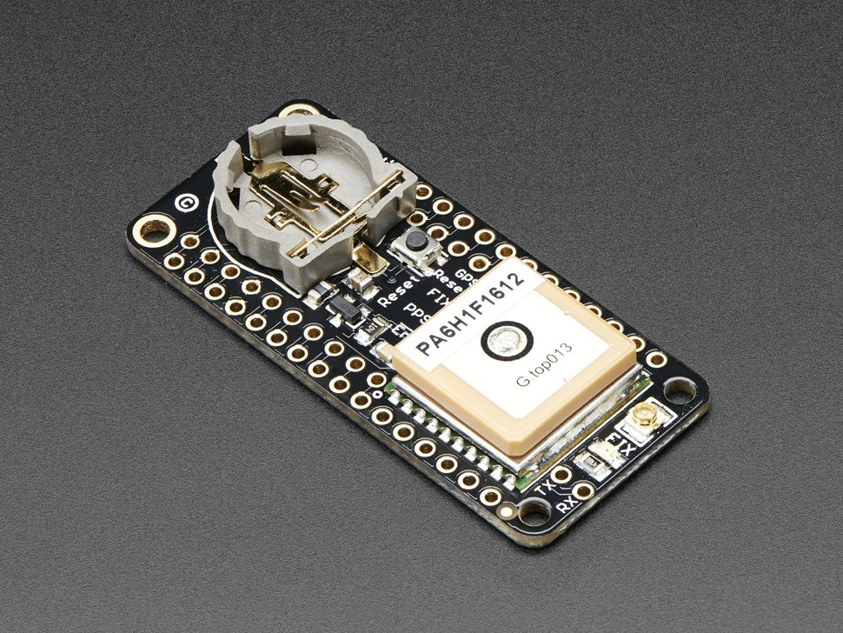
Adafruit Feather MO with LoRa Radio
Adafruit Ultimate GPS FeatherWing
Microcontroller
900 MHz Radio Transceiver
2 Km Line-of-sight
Tracks up to 22 satellites
10 Hz updates
Low Power Usage
Estimated cost for complete unit: $110 -$125

Slide 3
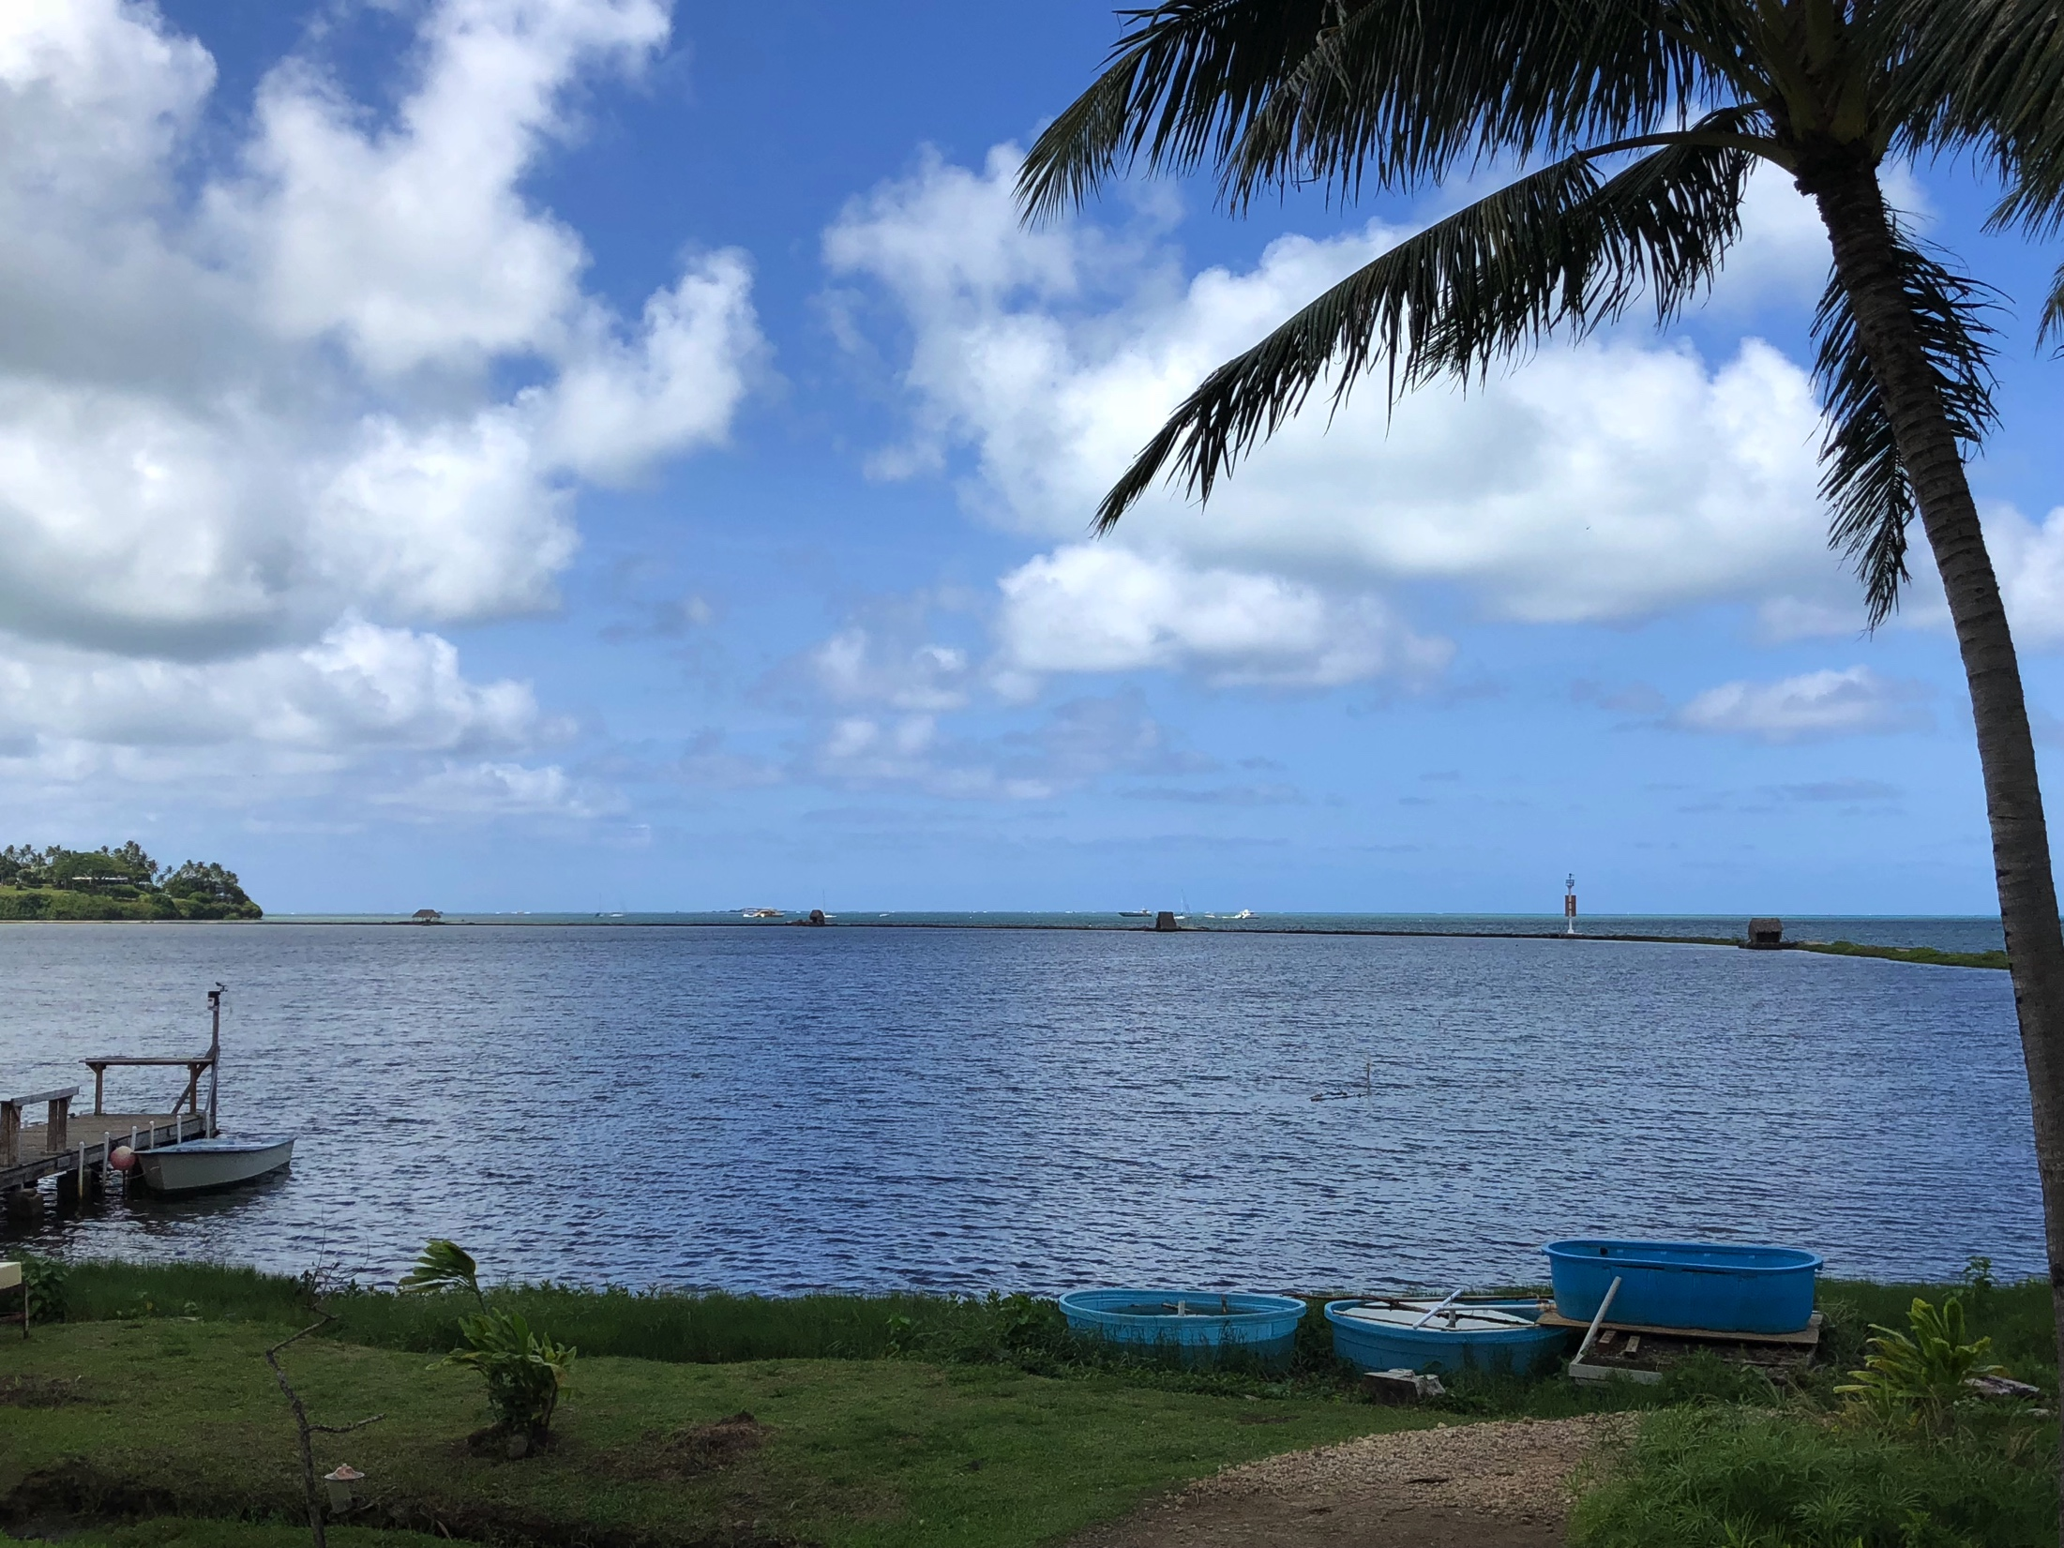
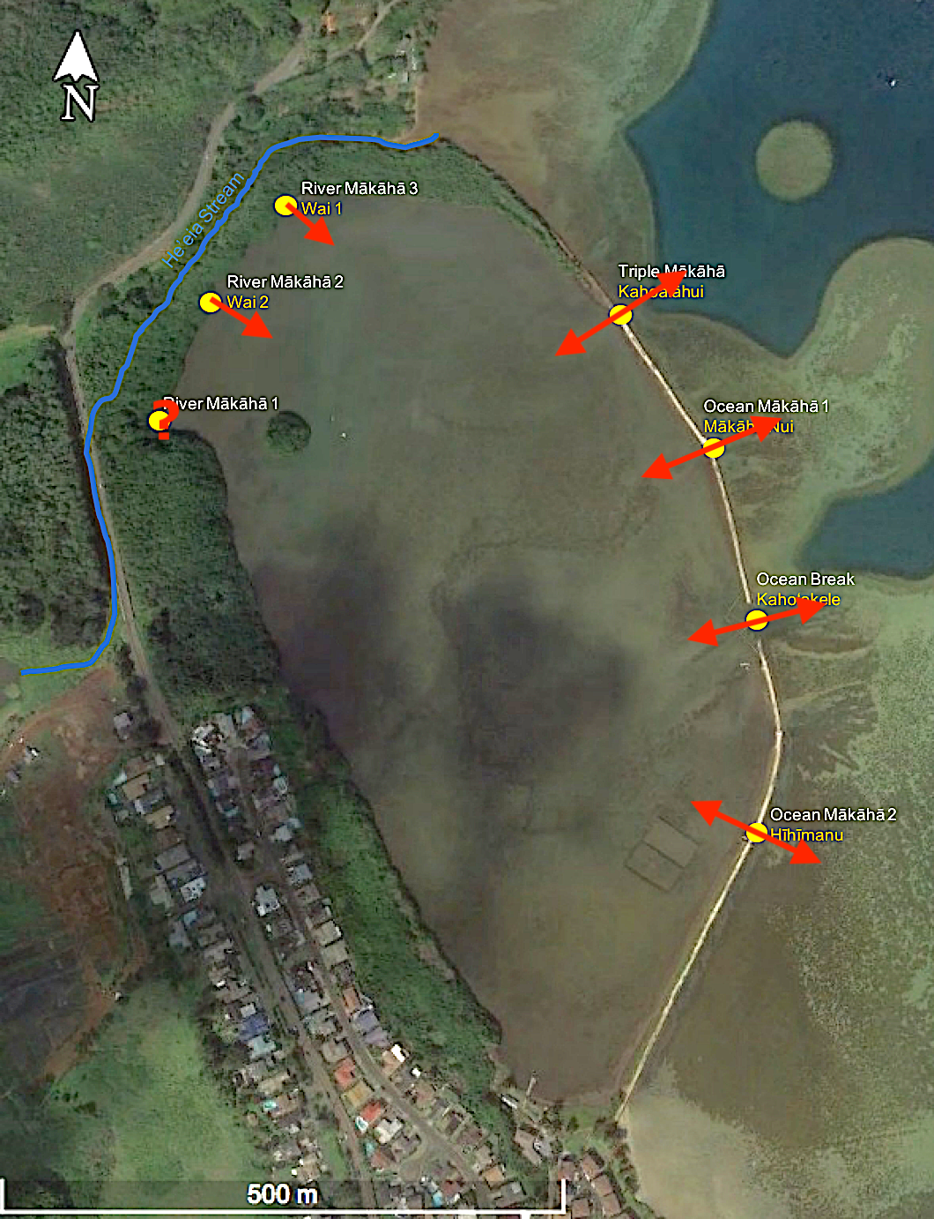
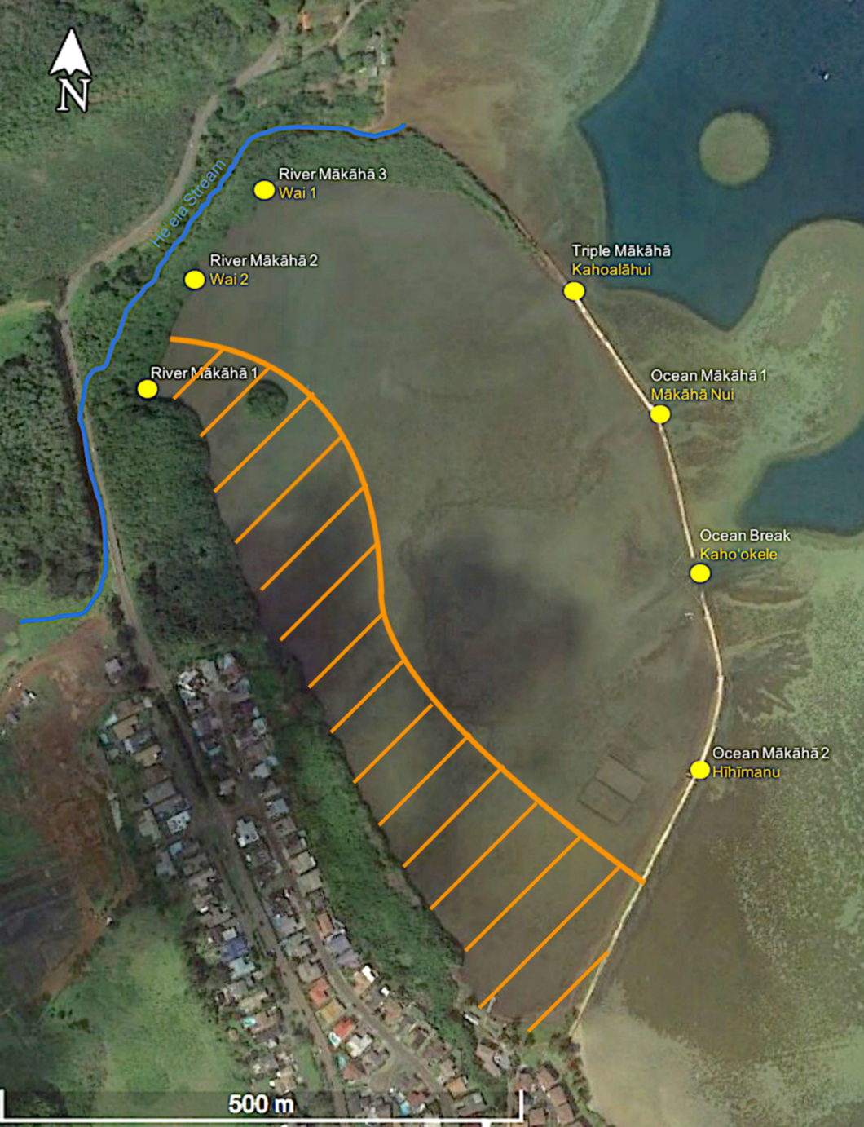
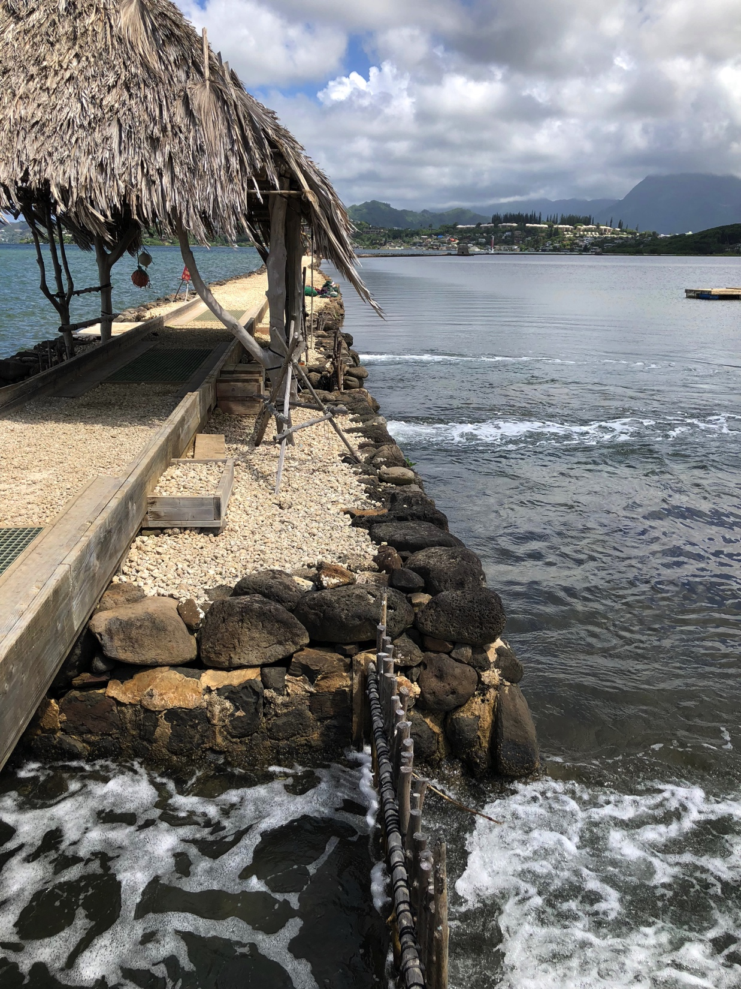

Slide 4
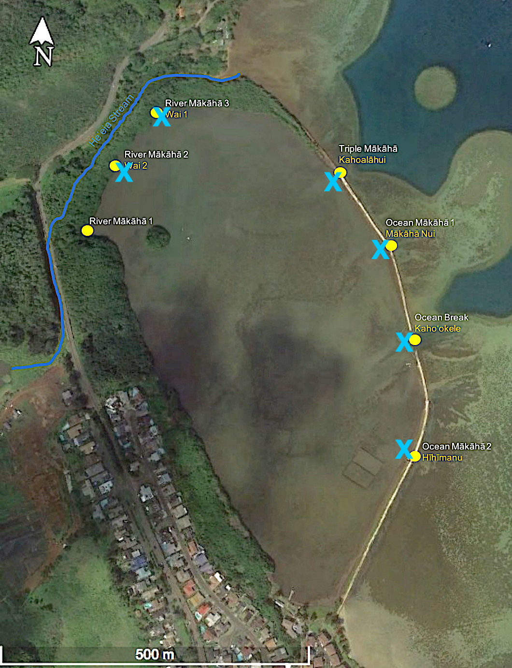

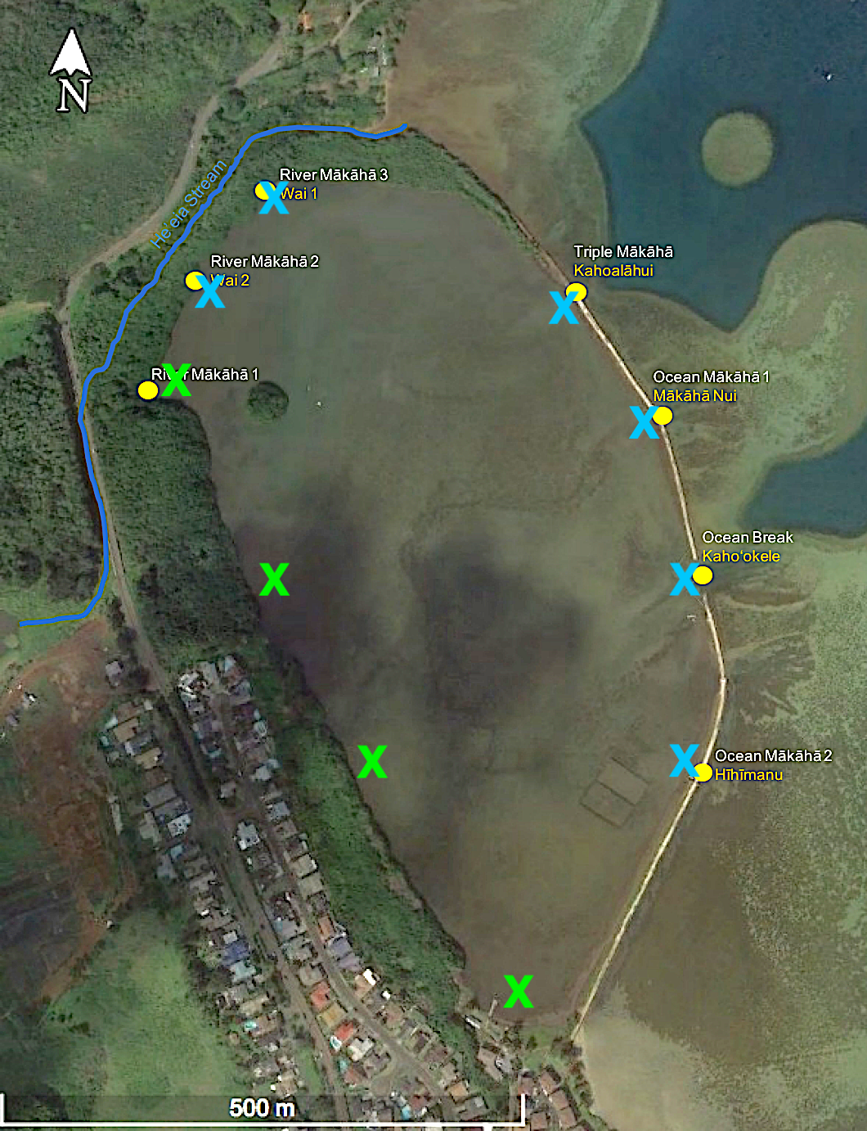
Deployments
1. Mākāhās at low slack tide
2. West boundary
3. Longitudinal axis

